Slide 1
Field study planning and data management

Slide 2
Data management:
the practice of collecting, organizing, protecting, and storing data so it can be analyzed.

Slide 3
Planning:
What do you want to know? Provide and prioritize main research questions and goals.
Why do you want to know? What is the intended purpose of the results?
When and where are you going to conduct the study? Explain why these locations and times were chosen.
List observation variables and experimental treatments and map out their relationships (i.e. hierarchical diagram of causes and effects).
List confounding variables and discuss their possible impacts on the proposed observations, based on their likely relationships with other variables.
How are you going to answer your research questions? Will the data collected be able to answer your research questions? Outline the analytical strategy that will be used.
Build a working example of what you expect your data to look like (i.e. simulate data) and analyze the simulated data set. Try alternative assumptions. Does this model yield expected results? Review the study plan.

Slide 4
Sampling protocol:
Summary of study goals.
Experimental or sampling design (e.g. sampling locations, variables to measure, fishing gear, …).
Data field descriptions and code definitions (e.g. hepato-colour codes).
Instrument list and settings (e.g. La*b* setting on colorimeter).
References for background studies, e.g. previous reports or studies using the sampling protocol.

Slide 5
Field observations:
Actual sampling locations, fishing gear and vessel. Include any changes to the original sampling protocol and explain why and how they were changed.
List of field technicians and brief description of duties.
Issues encountered which may have affected the experimental design or the data.
Event times (e.g. trap setting and retrieval times).
Some photos of gear, activities, measurements, and specimens.

Slide 6
Debriefing:
Review field data:
Variable names, definitions, formatting and contents (especially qualitative variables).
Index key variables (i.e. those used to link different data sets) should be well-defined.
Comment clarifications and corrections.
Basic plots for variables of interest.
Note any missing modifications that were made to the fishing or sampling protocols.
Discuss possible impacts that these modifications or other issues encountered during the study.
Make recommendations for next iteration of study.
Transfer data and metadata to study repository.

Slide 7
Fieldwork data management:
Before
During
After
Study goals
Biological observations
Sampling issues
Study design
Field observations
Data field descriptions
Sampling protocol
Photos
Protocol changes
References
Data
Metadata

Slide 8
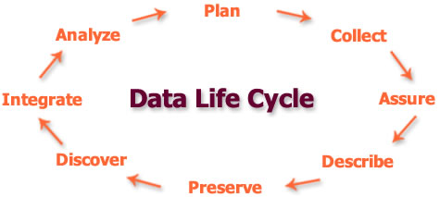
Question
Plan
Field work
Write-up
Describe
Analyze
Organize

